Slide 1
Database Management Systems

Slide 2
Grading
Written assignments 20%
Midterm Exam 30%
Final 50%

Slide 3
What is a Database Management System?
A Database Management System (DBMS) is a software package designed to store and manage databases:
  Manages very large amounts of data.
  2. Supports efficient access to very large amounts of data.
  3. Supports concurrent access to very large amounts of data.
    Example: bank and its ATM machines.
  4. Supports secure, atomic access to very large amounts of data.
    Contrast two people editing the same UNIX file – last to write “wins” – with the problem if two people deduct money from the same account via ATM machines at the same time – new balance is wrong whichever writes last.

Slide 4
Example: Online Bookseller
Data = information on books (including categories, bestsellers, etc.), customers, pending orders, order histories, etc.
  Massive: many gigabytes at a minimum for medium-size bookseller, more if keep all order histories over all time, even more if keep images of book covers and sample pages
    => Far too big for memory
  Persistent: data outlives programs that operate on it
  Multi-user: many people/programs accessing same database, or even same data, simultaneously
    => Need careful controls

Slide 5
Files vs. DBMS
Application must stage large datasets between main memory and secondary storage (e.g., buffering, page-oriented access, 32-bit addressing, etc.)
Special code for different queries
Must protect data from inconsistency due to multiple concurrent users
Crash recovery
Security and access control

Slide 6
What is a Relational Database?
Based on the relational model (tables):
  acct # name balance
  12345 Sally 1000.21
  34567 Sue 285.48
  … … …
Today used in most DBMS's.

Slide 7
The DBMS Marketplace
Relational DBMS companies – Oracle, – is among the largest software companies in the world.
IBM offers its relational DB2 system. With Integrated Management System ( IMS) , a nonrelational system, IBM is by some accounts the largest DBMS vendor in the world.
Microsoft offers SQL-Server, plus Microsoft Access for the cheap DBMS on the desktop
Relational companies also challenged by “object-oriented DB” companies.
But countered with “object-relational” systems, which retain the relational core while allowing type extension as in OO systems.

Slide 8
Three Aspects to Studying DBMS's
1. Modeling and design of databases.
  Allows exploration of issues before committing to an implementation.
2. Programming: queries and DB operations like update.
  SQL
3. DBMS implementation.

Slide 9
Query Languages
Employee
Department
Name
Dept
Dept
Manager
SQL
SELECT Manager
FROM Employee, Department
WHERE Employee.name = “Ali”
AND Employee.Dept = Department.Dept
Query Language
Data definition language (DDL) ~ like type defs in C or Pascal
Data Manipulation Language (DML)
Query (SELECT)
UPDATE < relation name >
SET <attribute> = < new-value>
WHERE <condition>

Slide 10
Host Languages
C, C++, Java, Lisp, COBOL
Application prog.
DBMS
Calls to
DB
Local Vars
(Memory)
(Storage)
Host language is completely general
Query language—less general "non procedural" and optimizable

Slide 11
Relational Model
Relational model is good for:
Large amounts of data —> simple operations
Navigate among small number of relations
Difficult Applications for relational model:
CAD
CASE
• Graphical Data

Slide 12
Other Models
Where number of "relations" is large, relationships are complex
  Object Data Model
  Logic Data Model
OBJECT DATA MODEL
  1. Complex Objects – Nested Structure (pointers or references)
  2. Encapsulation, set of Methods/Access functions
  3. Object Identity
  4. Inheritance – Defining new classes like old classes

Slide 13
Other Models
LOGIC (Horn Clause) DATA MODEL
• Prolog, Datalog:
    if A1 and A2 then B
    B:- A1 and A2
Functions s(5) = 6 (successor)
Predicates with Arguments: sum(X,Y,Z) ← X + Y = Z
  sum(X,0,X) means X + 0 = X (always true for all X)
  sum(X,s(Y),s(Z)):-sum(X,Y,Z) means X+(Y+1) = (Z+1) if X + Y = Z
More powerful than relational
  Can Compute Transitive Closure
  edge(X,Y).
  path(X,Y) :- edge(X,Y).
  path(X,Z) :- path(X,Y) & edge(Y,Z).

Slide 14
Data Models
60’s
70's
80's
90’s
now
Hierarchical
Network
Relational
Choice for most new applications
Object Bases
Knowledge Bases

Slide 15
Why Use a DBMS?
Data independence and efficient access.
Reduced application development time.
Data integrity and security.
Uniform data administration.
Concurrent access, recovery from crashes.
Notes:
3

Slide 16
Data Independence *
Applications isulated from how data is structured and stored.
Logical data independence: Protection from changes in logical structure of data.
Physical data independence: Protection from changes in physical structure of data.
One of the most important benefits of using a DBMS!

Slide 17
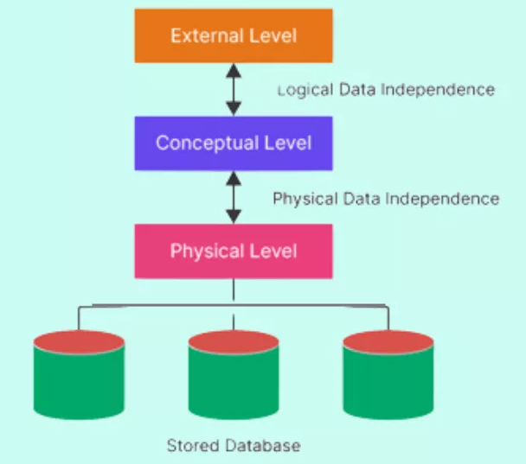
Data Independence *

Slide 18
Data Independence *
Data Independence means the ability of the data to change the schema at one level of the database without having to change the schema at the next higher level
In simple words, we can say that Data independence is a property of a database that allows the User or Database Administrator to change the schema at one level without affecting the data or schema at another level
Purpose: The purpose of data independence is to enhance the security of the system, save time and reduce costs needed once the information is changed or altered.
One of the most important benefits of using a DBMS!

Slide 19
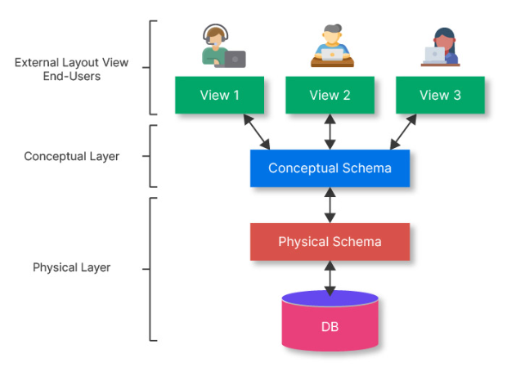
Levels of Abstraction
Many views, single conceptual (logical) schema and physical schema.
  Views describe how users see the data.
  Conceptual schema defines logical structure
  Physical schema describes the files and indexes used.
Notes:
6

Slide 20
Data Independence *
To achieve Data Independence, the first step is to ensure Data Abstraction. Data Abstraction can be defined as extracting the necessary data by ignoring the remaining irrelevant details.
If we take the example of a real-world entity, ATM is one of the best examples of data abstraction. We all use an ATM machine for cash withdrawals, money transfers, etc. in our daily life.
The main purpose of data abstraction is to achieve data independence. There are three levels of abstraction.
  Physical or Internal Level - Physical level is the lowest level of data abstraction and It indicates how the data will be stored and describes the complex data structures and access methods to be used by the database. The internal level is used to describe the entire database architecture.
  Conceptual or Logical Level - The Conceptual database schema is additionally called the logical structure because it defines the logical relations between the data. The separation of the conceptual view from the internal view enables us to provide a logical description of the database concepts without the need to specify physical structures. The conceptual level comes between the physical level and the view level. It provides the link between the external schema and the internal schema of the database.
  External or View Level - It is the highest level of data abstraction. The external level describes the user interaction with the centralized database management system. This level is used to provide a Graphical User Interface to the user, and the user does not know about the file structure, access method, and other internal details of the database.

Slide 21
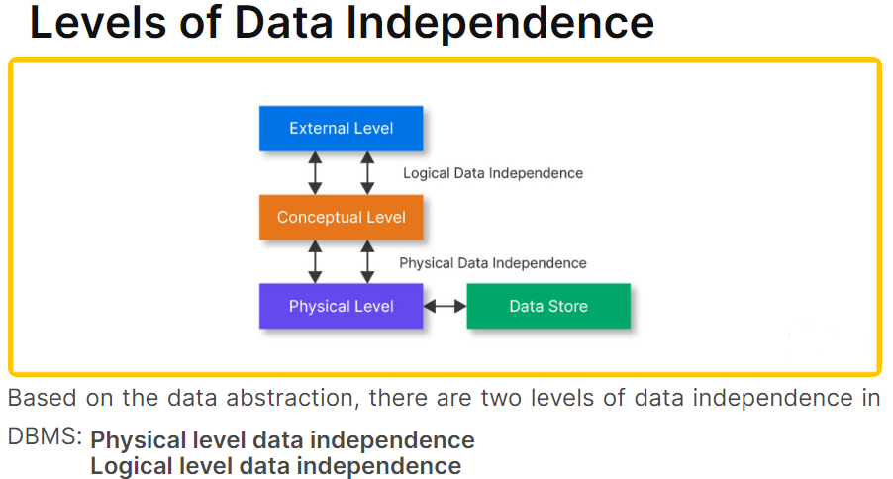
Data Independence *

Slide 22
Data Independence *
Physical Level Data Independence
  Physical Data Independence can be defined as the ability to change the physical level without affecting the logical or Conceptual level. Physical data independence gives us the freedom to modify the - Storage device, File structure, location of the database, etc. without changing the definition of conceptual or view level.
  Example: For example, if we take the database of the banking system and we want to scale up the database by changing the storage size and also want to change the file structure, we can do it without affecting any functionality of logical schema.
  Below changes can be done at the physical layer without affecting the conceptual layer -
    Changing the storage devices, hard disk and magnetic tapes, etc.
    Changing the access technique and modifying indexes.
    Changing the compression techniques or hashing algorithms.

Slide 23
Data Independence *
Logical Level Data Independence
  a property of a database that can be used to change the logic behind the logical level without affecting the other layers of the database.
  is usually required for changing the conceptual schema without having to change the external schema or application programs.
  It allows us to make changes in a conceptual structure like adding, modifying, or deleting an attribute in the database.
  Example: If there is a database of a banking system and we want to add the details of a new customer or we want to update or delete the data of a customer at the logical level data will be changed but it will not affect the Physical level or structure of the database.
  These changes can be done at a logical level without affecting the application program or external layer.
  Adding, deleting, or modifying the entity or relationship.
  Merging or breaking the record present in the database.

Slide 24
Concurrency Control
Concurrent execution of user programs is essential for good DBMS performance.
  Because disk accesses are frequent, and relatively slow, it is important to keep the cpu humming by working on several user programs concurrently.
Interleaving actions of different user programs can lead to inconsistency: e.g., check is cleared while account balance is being computed.
DBMS ensures such problems don’t arise: users can pretend they are using a single-user system.

Slide 25
Transaction: An Execution of a DB Program
Key concept is transaction, which is an atomic sequence of database actions (reads/writes).
Each transaction, executed completely, must leave the DB in a consistent state if DB is consistent when the transaction begins.
  Users can specify some simple integrity constraints on the data, and the DBMS will enforce these constraints.
  Beyond this, the DBMS does not really understand the semantics of the data. (e.g., it does not understand how the interest on a bank account is computed).
  Thus, ensuring that a transaction (run alone) preserves consistency is ultimately the user’s responsibility!

Slide 26
Transaction: An Execution of a DB Program
Transaction: An executing program (process) that includes one or more database access operations
  Read operations (database retrieval, such as SQL SELECT)
  Write operations (modify database, such as SQL INSERT, UPDATE, DELETE)
  Transaction: A logical unit of database processing
  Example: Bank balance transfer of $100 dollars from a checking account to a saving account in a BANK database
Note: Each execution of a program is a distinct transaction with different parameters
  Bank transfer program parameters: savings account number, checking account number, transfer amount

Slide 27
Transaction: An Execution of a DB Program
A transaction (set of operations) may be:
  stand-alone, specified in a high level language like SQL submitted interactively, or
  consist of database operations embedded within a program (most transactions)
Transaction boundaries: Begin and End transaction.
  Note: An application program may contain several transactions separated by Begin and End transaction boundaries

Slide 28
Transaction: An Execution of a DB Program
Transaction Processing Systems: Large multi-user database systems supporting thousands of concurrent transactions (user processes) per minute
Two Modes of Concurrency
  Interleaved processing: concurrent execution of processes is interleaved in a single CPU
  Parallel processing: processes are concurrently executed in multiple CPUs (Figure 1.1)
  Basic transaction processing theory assumes interleaved concurrency

Slide 29
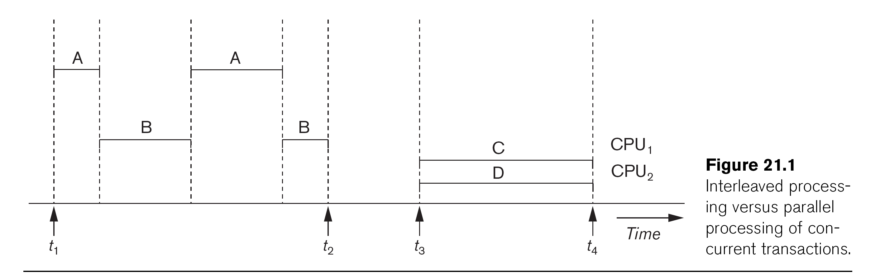

Slide 30
Transaction: An Execution of a DB Program
For transaction processing purposes, a simple database model is used:
A database - collection of named data items
Granularity (size) of a data item - a field (data item value), a record, or a whole disk block
  TP concepts are independent of granularity
Basic operations on an item X:
  read_item(X): Reads a database item named X into a program variable. To simplify our notation, we assume that the program variable is also named X.
  write_item(X): Writes the value of program variable X into the database item named X.

Slide 31
Transaction: An Execution of a DB Program
READ AND WRITE OPERATIONS:
Basic unit of data transfer from the disk to the computer main memory is one disk block (or page). A data item X (what is read or written) will usually be the field of some record in the database, although it may be a larger unit such as a whole record or even a whole block.
read_item(X) command includes the following steps:
Find the address of the disk block that contains item X.
Copy that disk block into a buffer in main memory (if that disk block is not already in some main memory buffer).
Copy item X from the buffer to the program variable named X.

Slide 32
Transaction Notation
Figure 1.2 (next slide) shows two examples of transactions
Notation focuses on the read and write operations
Can also write in shorthand notation:
  T1: b1; r1(X); w1(X); r1(Y); w1(Y); e1;
  T2: b2; r2(Y); w2(Y); e2;
bi and ei specify transaction boundaries (begin and end)
i specifies a unique transaction identifier (TId)

Slide 33
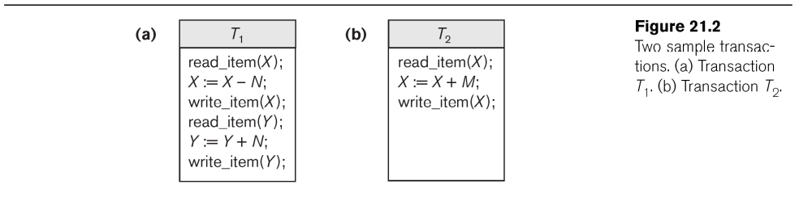

Slide 34
Scheduling Concurrent Transactions
DBMS ensures that execution of {T1, ... , Tn} is equivalent to some serial execution T1’ ... Tn’.
  Before reading/writing an object, a transaction requests a lock on the object, and waits till the DBMS gives it the lock. All locks are released at the end of the transaction. (Strict 2PL locking protocol.)
  Idea: If an action of Ti (say, writing X) affects Tj (which perhaps reads X), one of them, say Ti, will obtain the lock on X first and Tj is forced to wait until Ti completes; this effectively orders the transactions.
  What if Tj already has a lock on Y and Ti later requests a lock on Y? (Deadlock!) Ti or Tj is aborted and restarted!

Slide 35
Ensuring Atomicity
DBMS ensures atomicity (all-or-nothing property) even if system crashes in the middle of a Xact.
Idea: Keep a log (history) of all actions carried out by the DBMS while executing a set of Xacts:
  Before a change is made to the database, the corresponding log entry is forced to a safe location. (WAL protocol (Write-Ahead Logging for ensuring data integrity); OS support for this is often inadequate.)
  After a crash, the effects of partially executed transactions are undone using the log.

Slide 36

Databases make these folks happy
End users and DBMS vendors
DB application programmers
  e.g., smart webmasters
Database administrator (DBA)
  Designs logical /physical schemas
  Handles security and authorization
  Data availability, crash recovery
Must understand how a DBMS works!
Notes:
21

Slide 37
Structure of a DBMS
These layers
must consider
concurrency
control and
recovery
A typical DBMS has a layered architecture.
The figure does not show the concurrency control and recovery components.
This is one of several possible architectures; each system has its own variations.
Query Optimization
and Execution
Relational Operators
Files and Access Methods
Buffer Management
Disk Space Management
DB
Notes:
22

Slide 38

Summary
DBMS used to maintain, query large datasets.
Benefits include recovery from system crashes, concurrent access, quick application development, data integrity and security.
Levels of abstraction give data independence.
A DBMS typically has a layered architecture.
DBAs hold responsible jobs and are well-paid! ☺
DBMS R&D is one of the broadest, most exciting areas in CS.

